Slide 1

Population Growth in India
Intra-Hall Takneek, Team Challengers

Slide 2

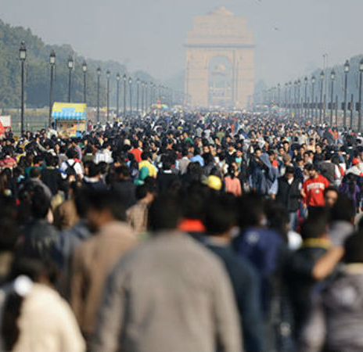
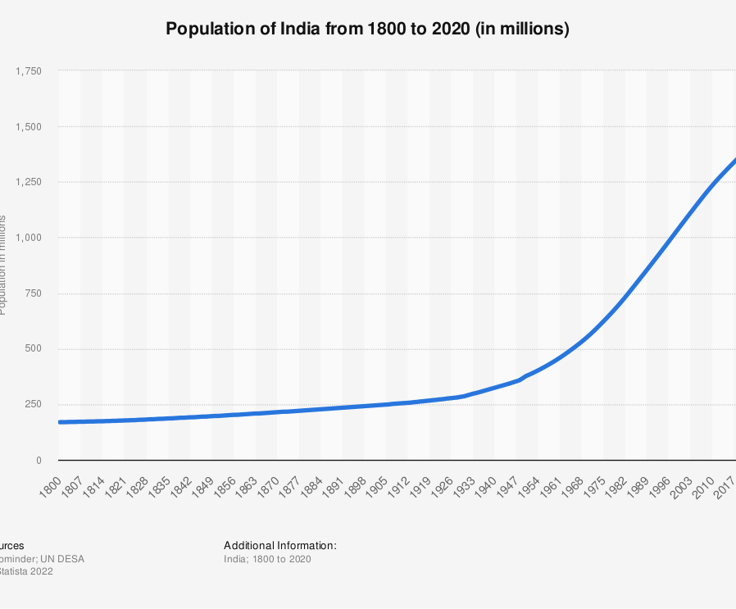
India’s Population Problem
According to recent estimates, India has overtaken China to become the world’s most populous nation.
India’s population stands at around 141 crores in 2022, up from about 34 crores in 1947.
It is imperative to take action to prevent further rise.

Slide 3
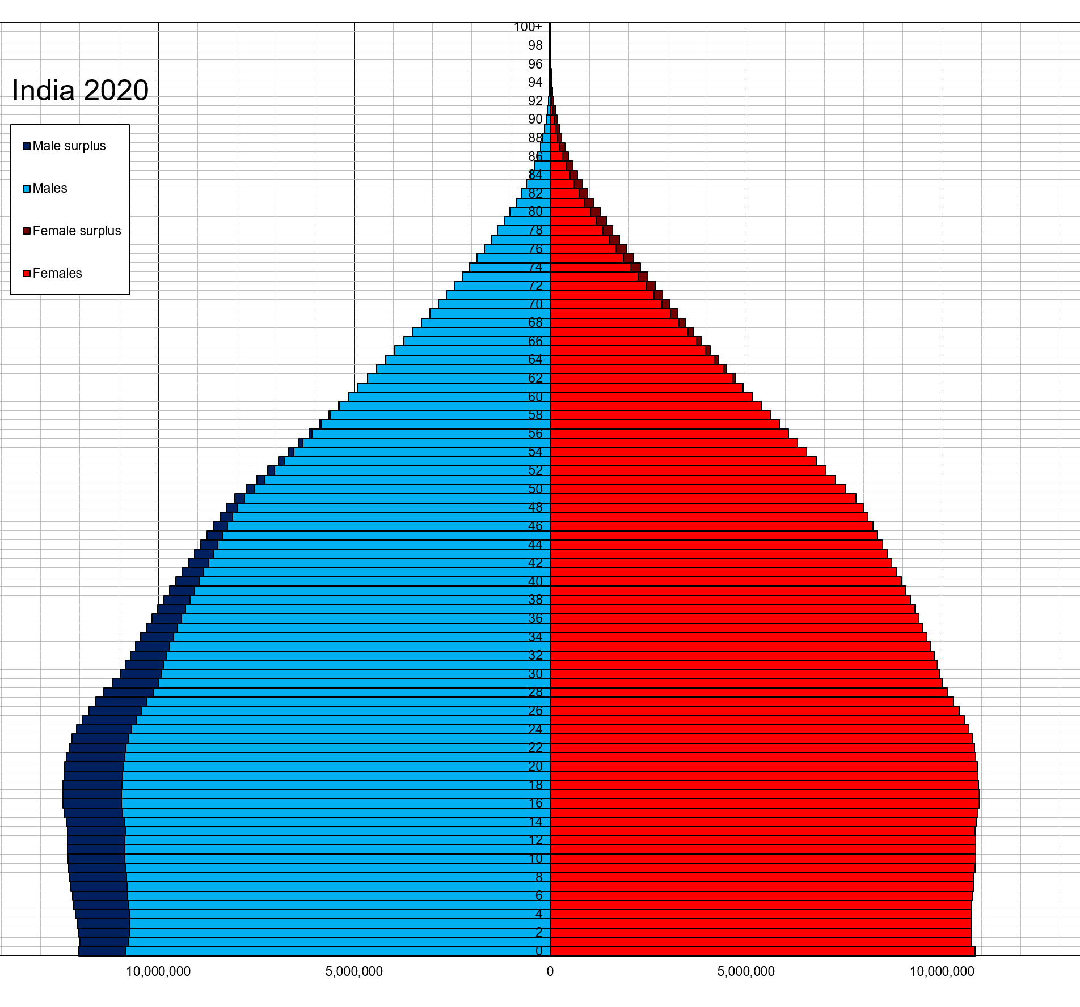
Good News: the number of children in India has already peaked. India is already on its way to achieving a stable population.
{
Stable number of children

Slide 4

The Situation Now
Challenge
How to begin to solve it?
While the nation as a whole is already close to the ideal replacement rate fertility of 2.1, the states of UP, Bihar, Jharkhand and Meghalaya exceed that. This is especially challenging for our nation as these are also among the poorest and least developed states of India.
The focus should be narrowed down to these specific states to maximise the efficiency of the government schemes and interventions needed. The next slide details how the states are to be classified for population management purposes after doing an analysis of their fertility rates.

Slide 5
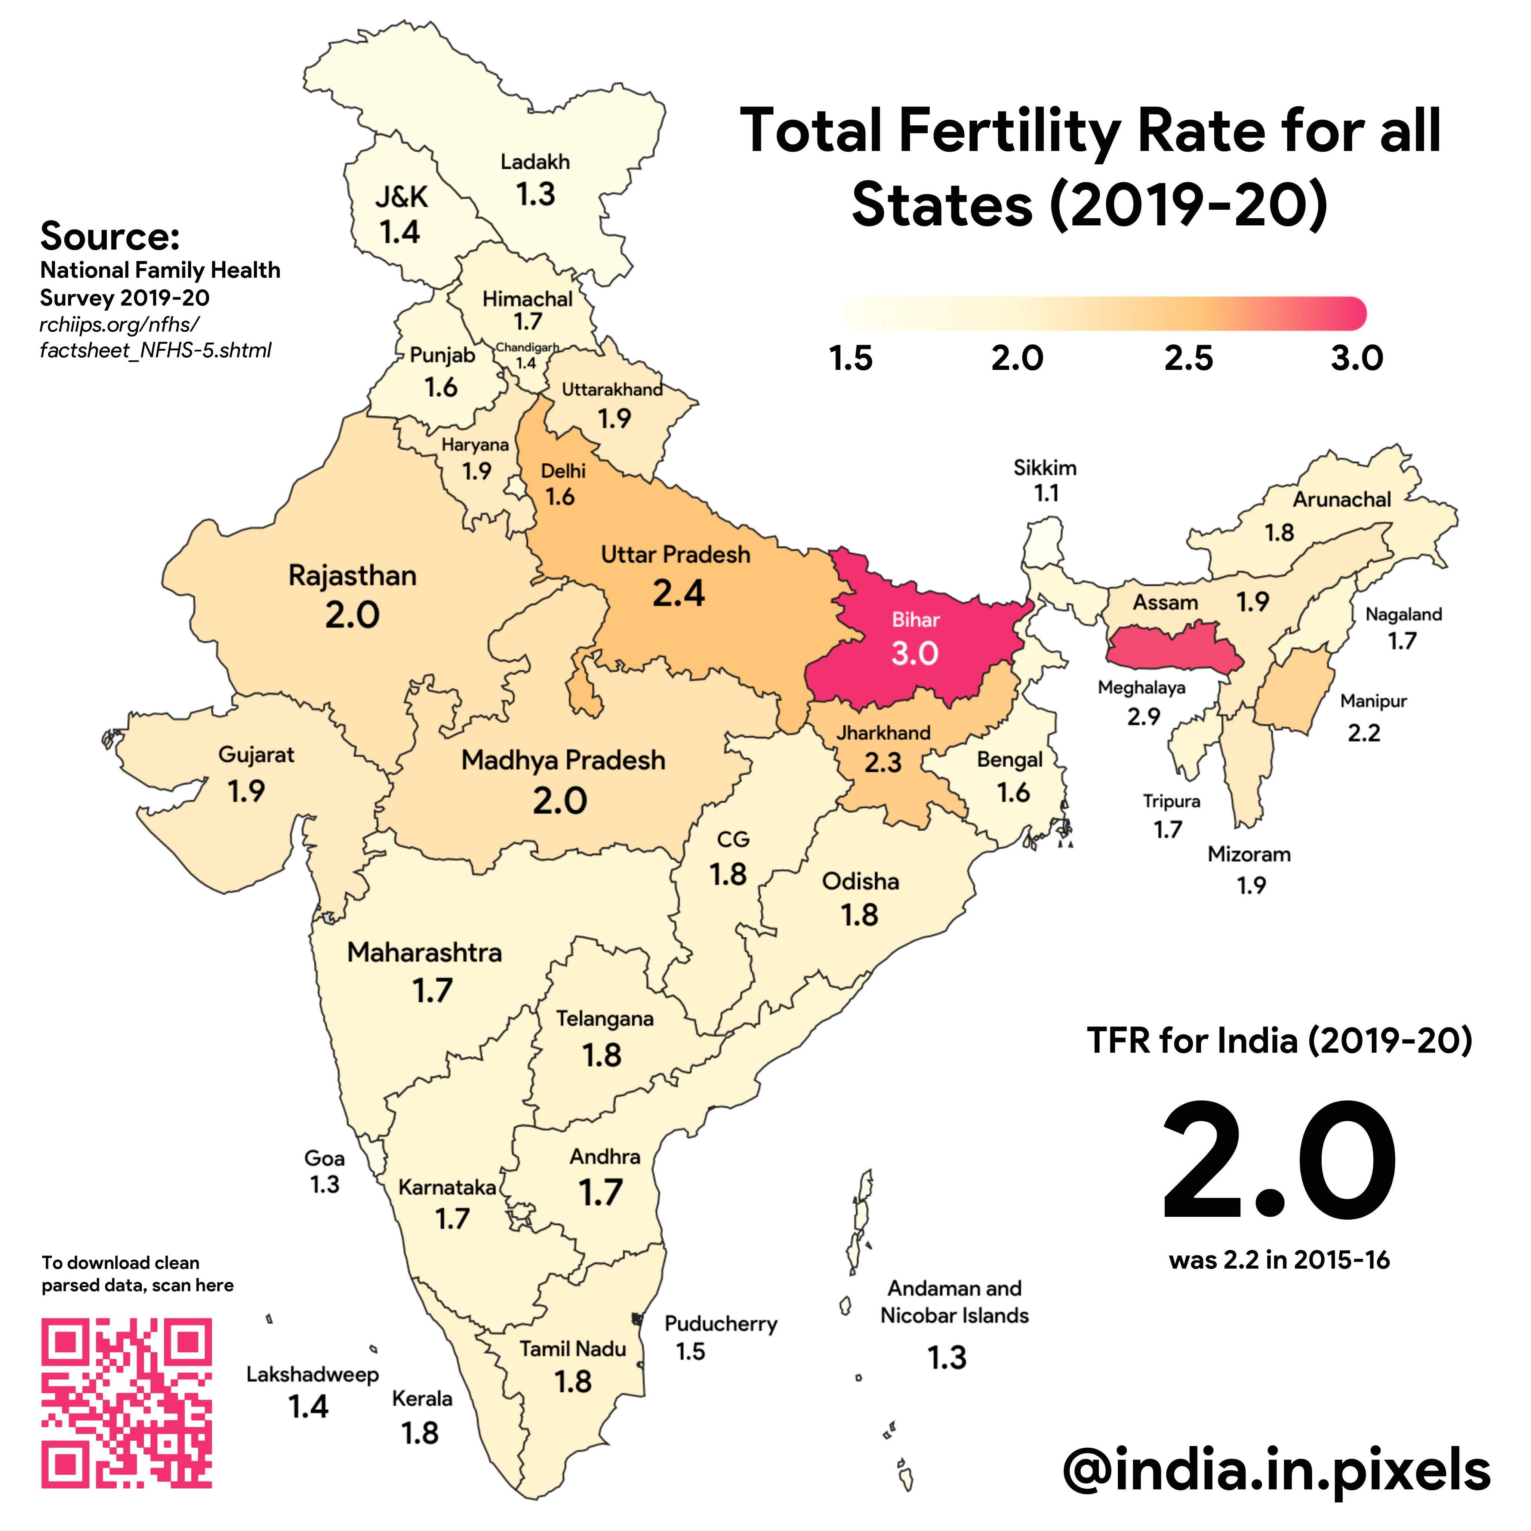
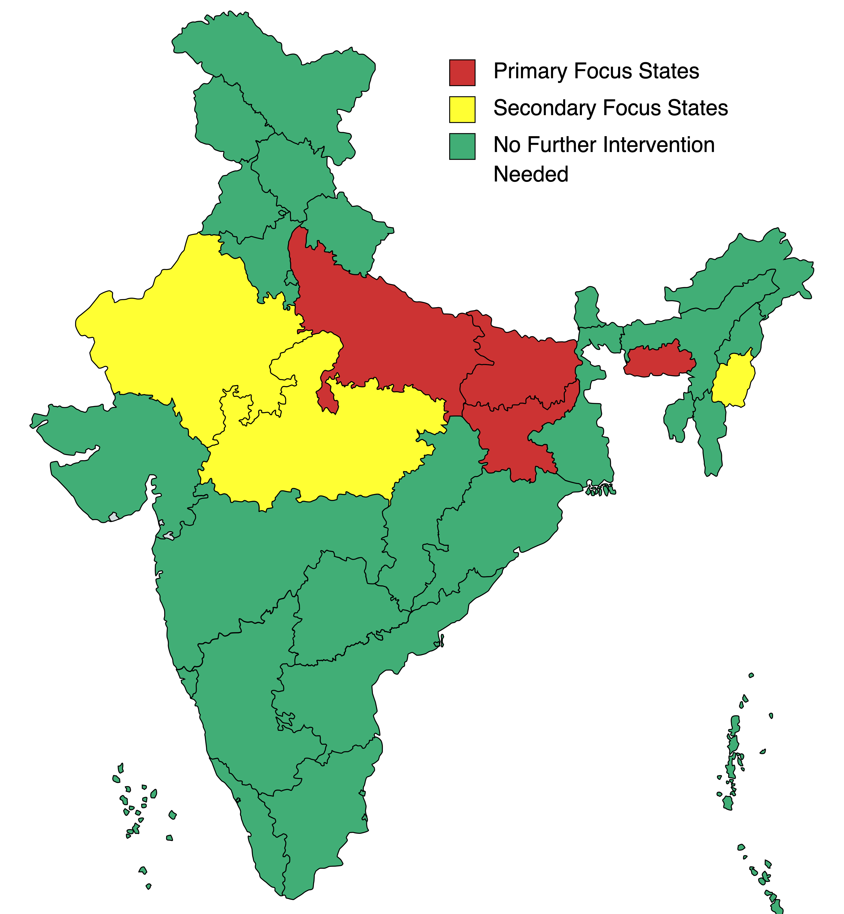

Slide 6
The Classification
Primary Focus States | Secondary Focus States | No further Intervention Needed
Bihar, UP, Jharkhand, Meghalaya | Rajasthan, Madhya Pradesh, Manipur | All other states and UTs.

Slide 7

So what’s the solution? Simple: The majority of states have already achieved a below-replacement fertility rate. The policies these states have already championed can be employed in the ‘Primary Focus States’.
Kerela could be an excellent template, given the state’s achievements in population control and human development...

Slide 8
Kerela’s Success
The BBC reported that:
Women's health in Kerala is the best in all of India. Mothers can gain easy access to health centres to help them care for their children.
Women are being educated. In Kerala, 92 per cent of females are literate as opposed to 70 per cent for all of India's women. Better educated mothers keep their children healthier, causing infant mortality (child deaths) rates to reduce. This leads to lower birth rates, as more babies survive
Contraception is widely available in Kerala, and couples can plan when they have children.

Slide 9


The 10 year roadmap designed by us
The roadmap has targets to be achieved within specific completion times in the “Primary Focus States”.
The goals have been designed so that the easiest targets can be achieved first to ensure the fastest possible achievement towards population control. Work on all targets, however, should start immediately.

Slide 10
The 10-year Roadmap
Within 1 year
Improving Rural hospitals to improve women’s and children’s health. A reduced Infant mortality rate would encourage families to not be tempted to have multiple babies.
More and better child care ‘Anganwadi’ so that women can join the workforce.
Ensure 100% coverage of both.
5 years
3 years
It has been seen that richer regions have lower fertility rates than poorer regions.
Increased industrialisation in ‘Critical Focus States’ with an emphasis on Women’s Employment: This could be done through special tax breaks/ other incentives for companies to set up in these states.
10 years
Targets that can be achieved quickly, i.e. the ‘low hanging fruit’:
Making effective contraceptives and awareness about them available in rural hospitals.
Strictly enforcing the minimum age of marriage for women.
Investment in schools and education for higher human development. The target should be 100% enrolment till Class 10th and 90%+ in further vocational or academic programmes.

Slide 11

But what about mandatory one/two-child policy?
ITS SIMPLY NOT NECESSARY!
India as a whole is already on its way to achieving a stable population... We don’t need draconian measures as in China.
It would be cruel to force already pregnant mothers to abort their baby, and it would be a huge human rights violation to discriminate against children of parents with multiple kids: they didn’t choose where they wanted to be born, it’s not their fault if their parents didn’t engage in proper family planning.
Practices like forced sterilisation could be interpreted as genocide.
Population control can be achieved in a more widely accepted way by using the roadmap we gave.

Slide 12
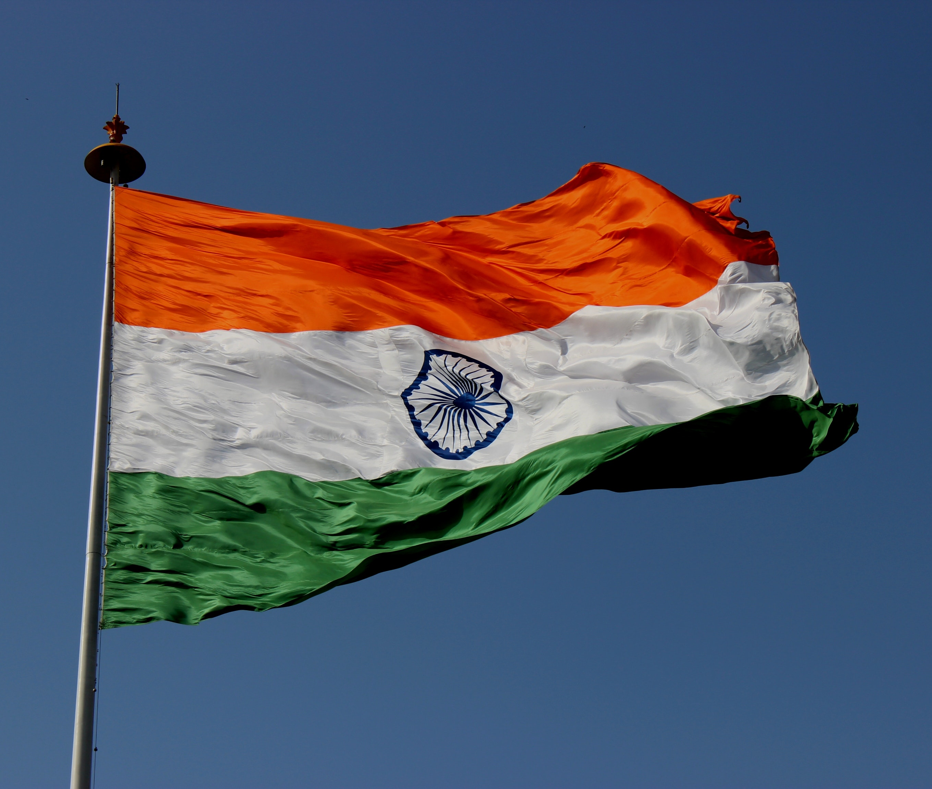
Thank You
Team Challengers Members:
Aditya Gautam
Aditya Prakash
Akshit Shukrawal
Jay Jain

Slide 13
Sources
https://en.wikipedia.org/wiki/List_of_states_and_union_territories_of_India_by_fertility_rate
https://thediplomat.com/2023/01/india-is-the-worlds-most-populous-country-what-it-means/
https://ourworldindata.org/indias-population-growth-will-come-to-an-end
https://www.bbc.co.uk/bitesize/guides/zgwm4j6/revision/3
https://www.bloomberg.com/news/articles/2023-01-18/india-s-population-overtakes-china-to-become-world-s-biggest-analysts-estimate#xj4y7vzkg

